Slide 1
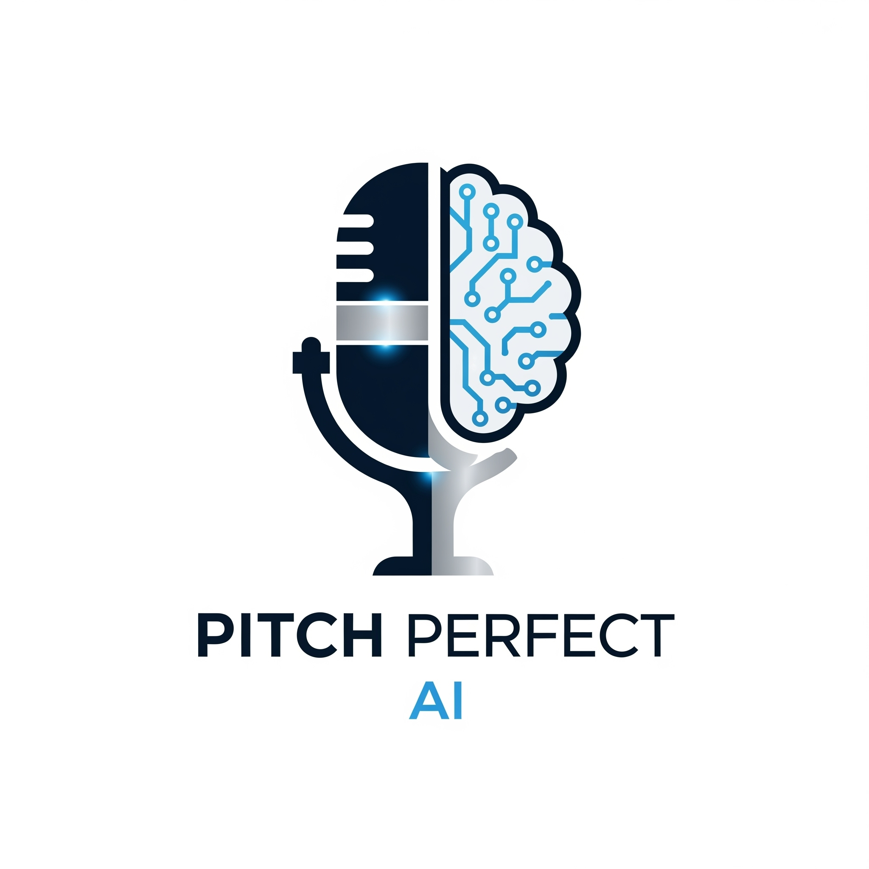
Pitch Perfect AI
An AI-powered application that analyzes your speech patterns, tone, and content to provide instant, data-driven feedback, helping you refine your communication skills and deliver impactful presentations.
Notes:
Good morning, judges. My name is [Your Full Name], and I'm excited to present Pitch Perfect AI.

Slide 2

Fear of the Podium
Public speaking is a common fear
Improving requires objective, private feedback
Lack of feedback hinders public speaking growth
Notes:
We've all been there. You have a huge presentation coming up, or a nerve-wracking job interview, and you're filled with anxiety. You practice in front of a mirror, but you're essentially speaking into a void. You have no objective way of knowing: Am I speaking too fast? Am I using distracting filler words like 'um' and 'like'? Is my message actually landing? Getting honest, private, and instant feedback is nearly impossible.

Slide 3
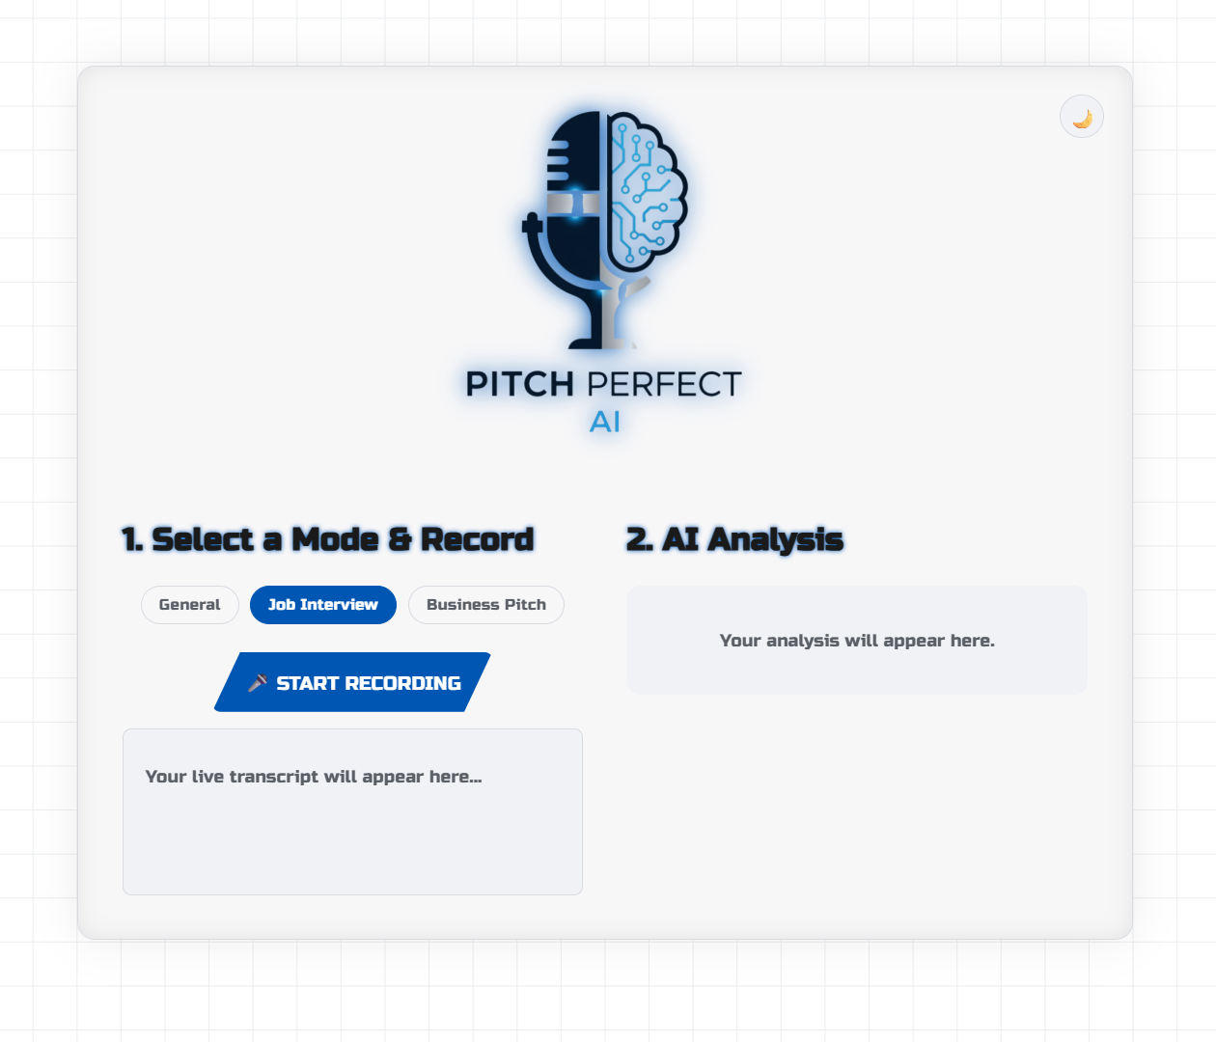
Introducing Pitch Perfect AI
Master Your Delivery: Get instant AI feedback on your clarity, pace, and filler words.
Build Real Confidence: Practice in a private, gamified environment designed to make you a better speaker.
Notes:
That is the exact problem I built Pitch Perfect AI to solve. It's a web application that acts as your personal, on-demand speaking coach. It provides a private, judgment-free space to practice your speech and receive immediate, data-driven feedback from a world-class AI, turning a stressful task into an engaging, game-like experience.

Slide 4
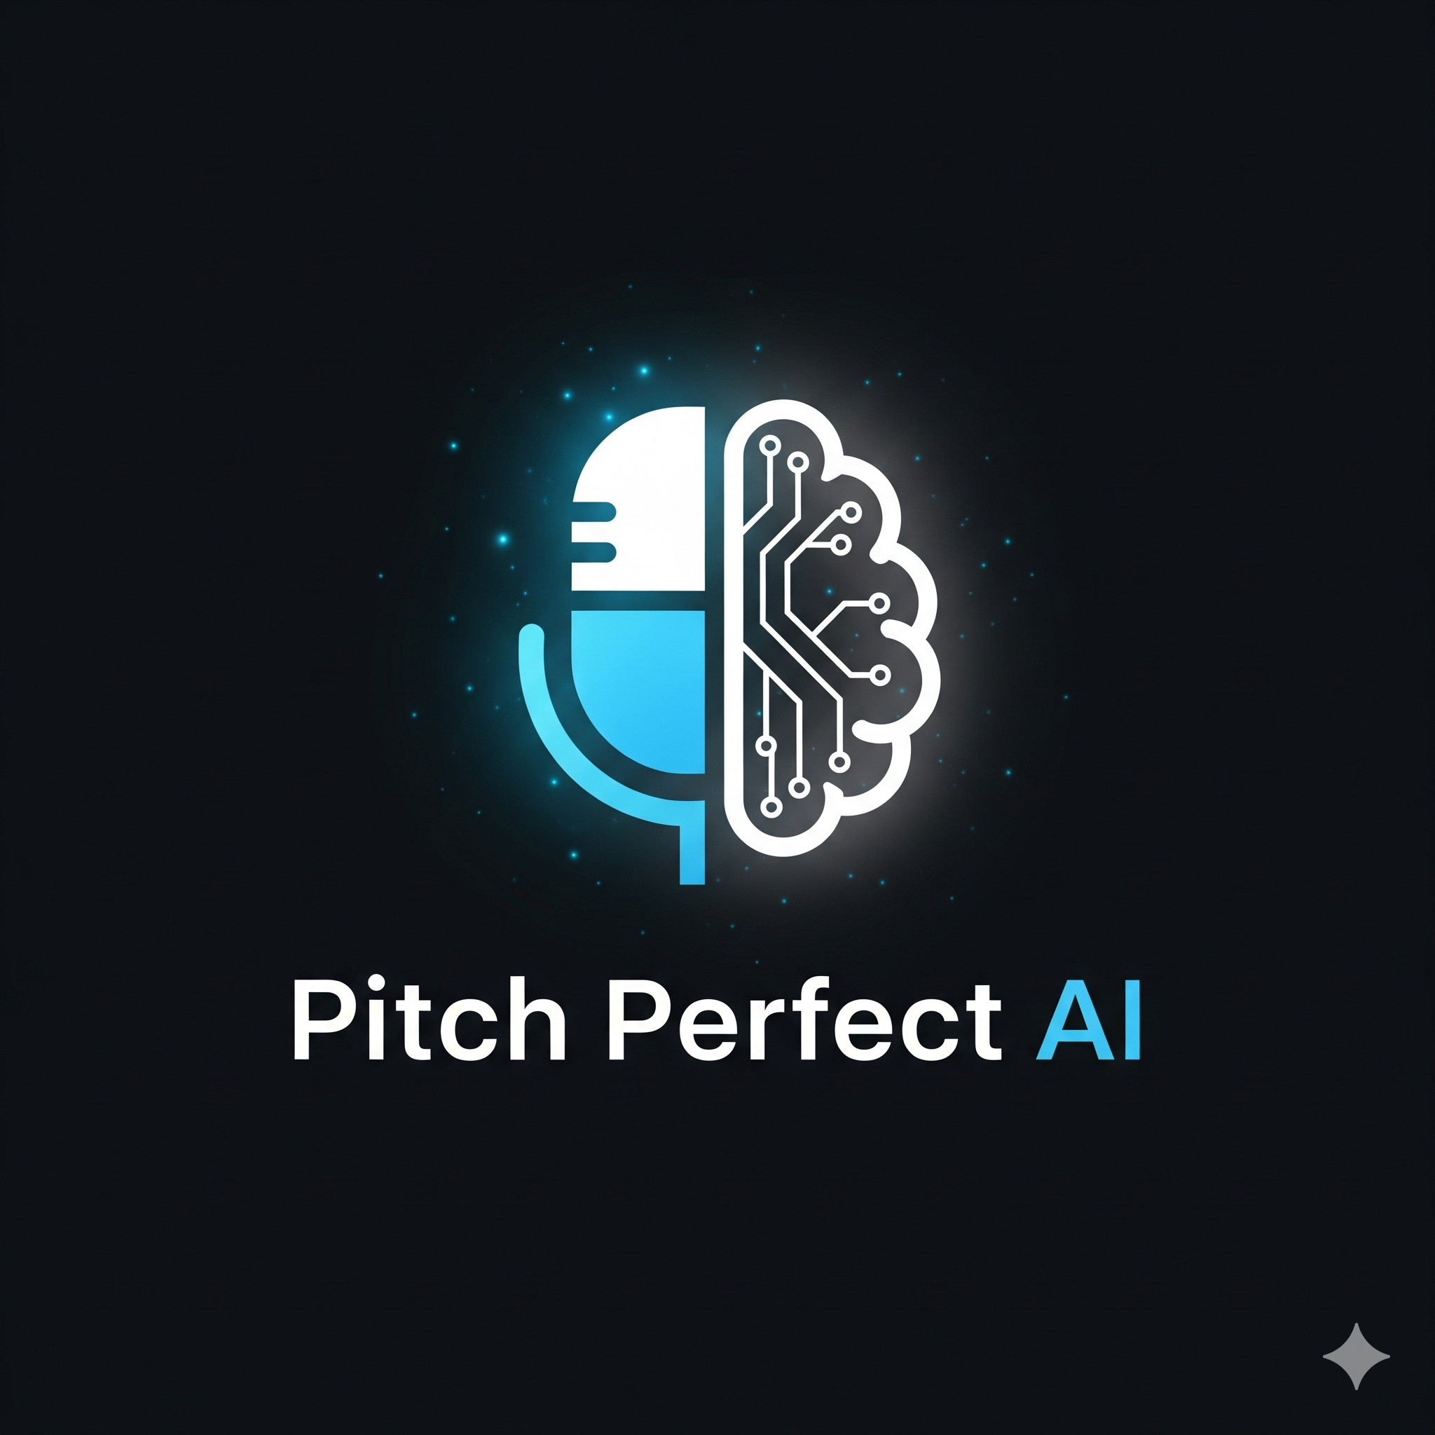
Live Demonstration
Witness a real-time, interactive demonstration of Pitch Perfect AI
See how the AI coach provides instant, data-driven feedback
Observe the user-friendly interface in action during the demo
Experience the gamified environment for engaging practice sessions

Slide 5
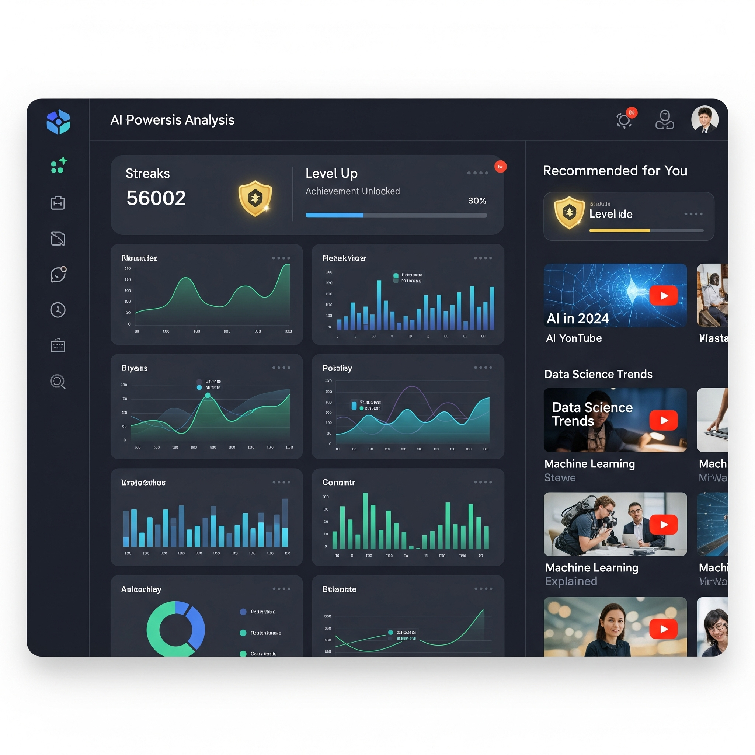
Features & Tech Stack
🤖 AI-Powered Analysis
🎯 Contextual Coaching Modes
🏅 Gamified Badges & Rewards
▶️ YouTube Recommendations
🌙 Accessible Dark Mode
Notes:
So, as you saw in the demo, Pitch Perfect AI is more than just a recorder; it's a complete coaching tool. We've implemented Contextual Coaching Modes to provide tailored feedback, and a Gamified Badge System to reward users for hitting key milestones, which directly follows the hackathon's gamification guidance.
On the tech side, this is a modern React and Vite application, which is fast and responsive. The core analysis is powered by Google's Gemini AI, and all the user-facing design is focused on accessibility, with features like a fully functional Dark Mode

Slide 6
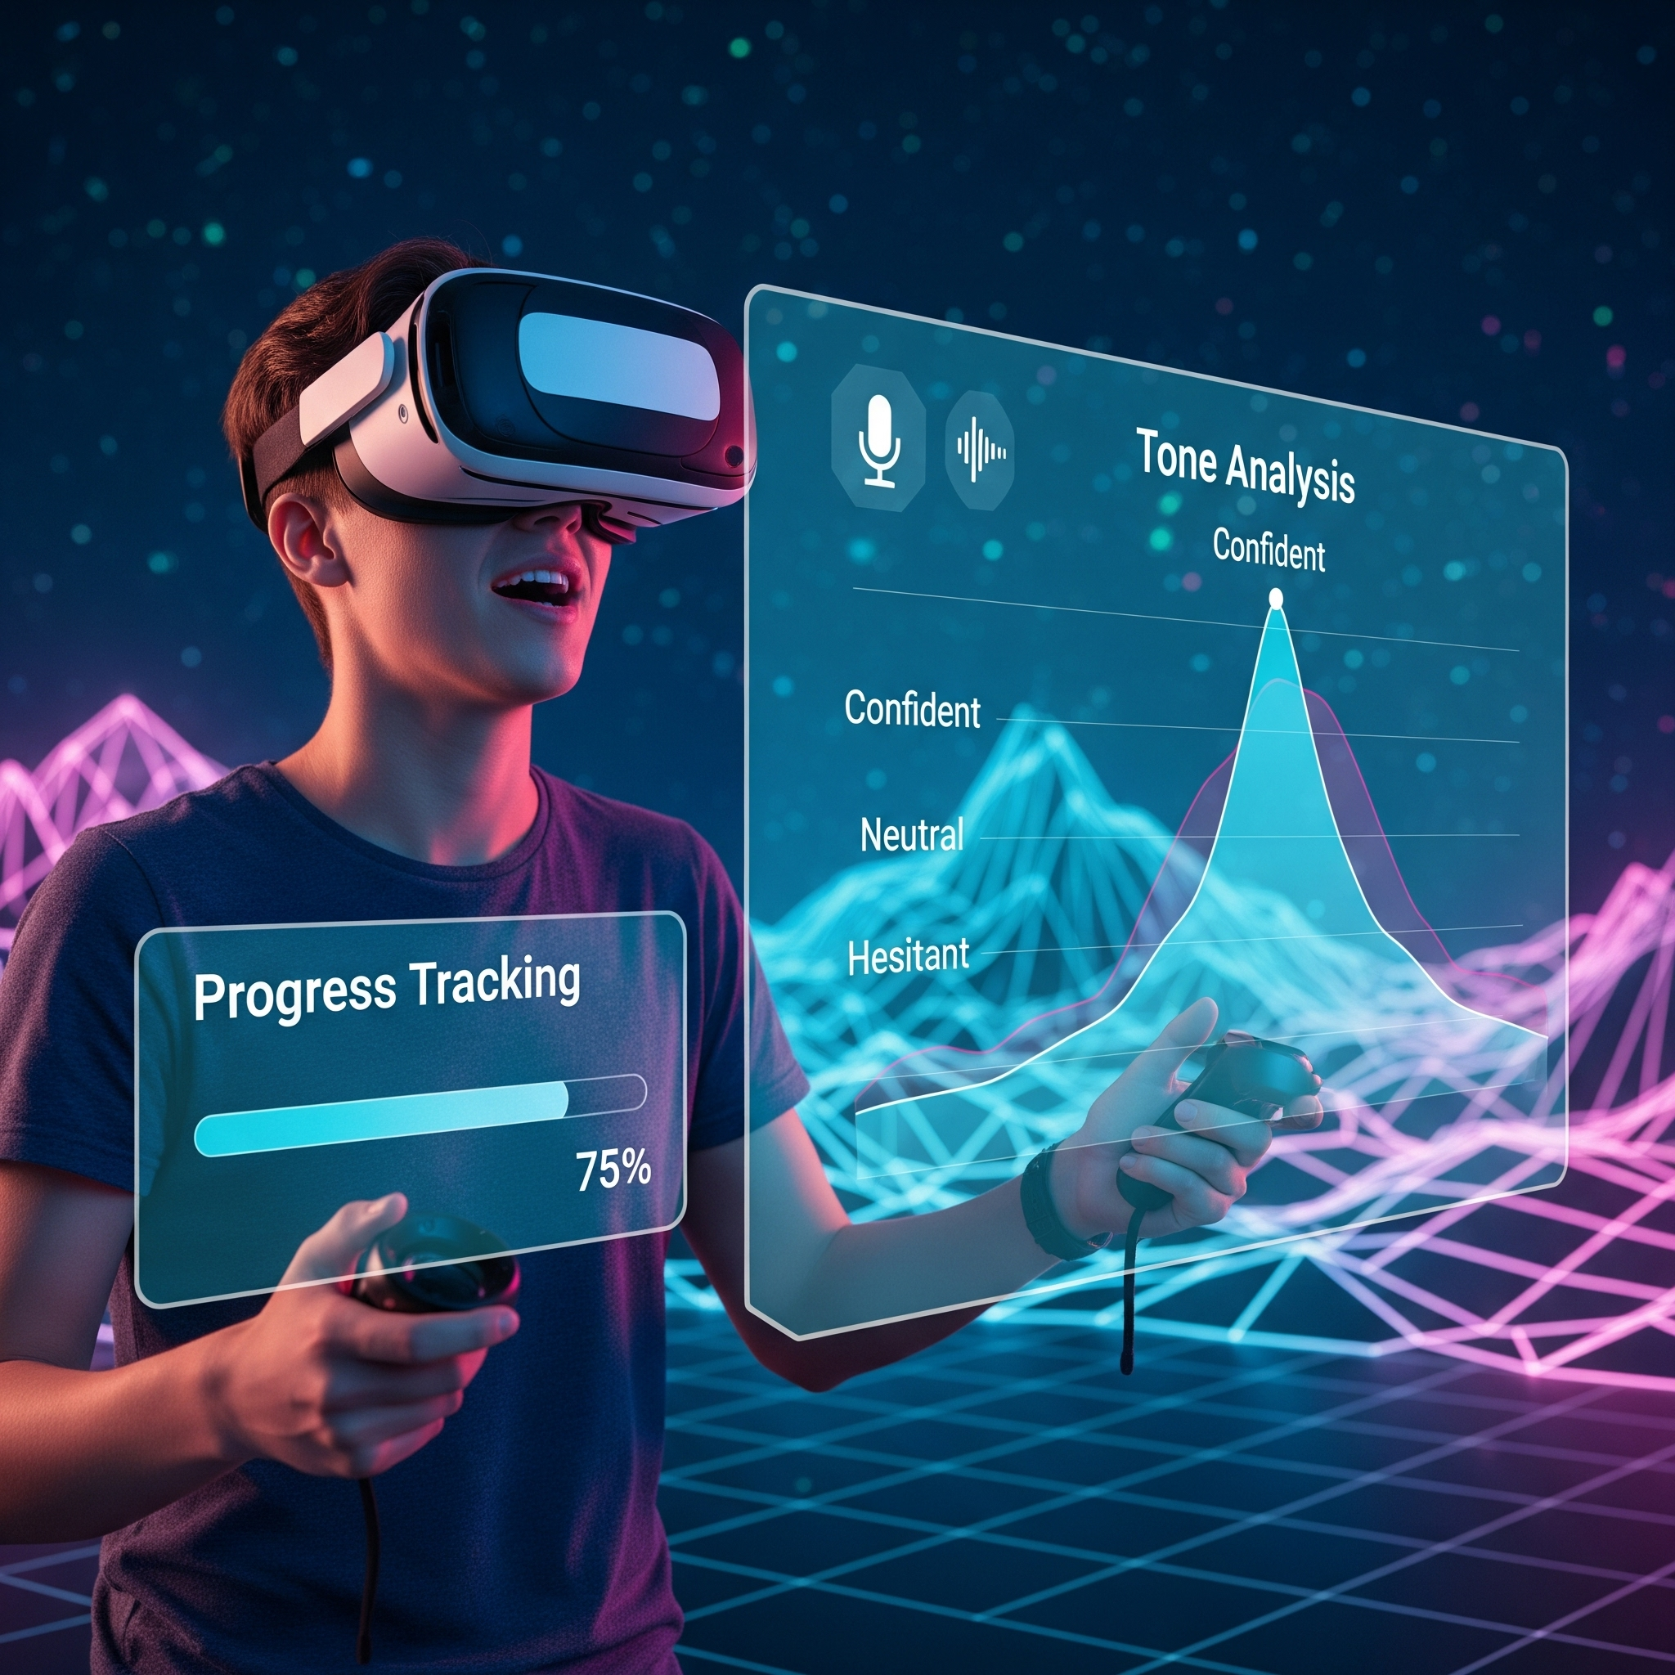
What's Next?
Implement audio playback for tone analysis
Develop a dashboard to track progress
Integrate virtual reality practice environments
Highlight filler words on the transcript
Notes:
This is just the beginning for Pitch Perfect AI. The next logical steps are to implement audio playback so users can analyze their vocal tone, and a progress dashboard to visually track their improvement over time, creating a complete learning journey. This addresses the Impact & Potential criterion by showing a clear path to a sustainable and even more helpful product

Slide 7
Thank You & Q&A
Thank you for your attention
We appreciate your time and interest
Now open for questions and discussion
Notes:
Pitch Perfect AI is a tool designed to empower anyone, from students to professionals, to build the confidence they need to make their voice heard.
Thank you for your time. I'm now open to any questions

